Slide 1
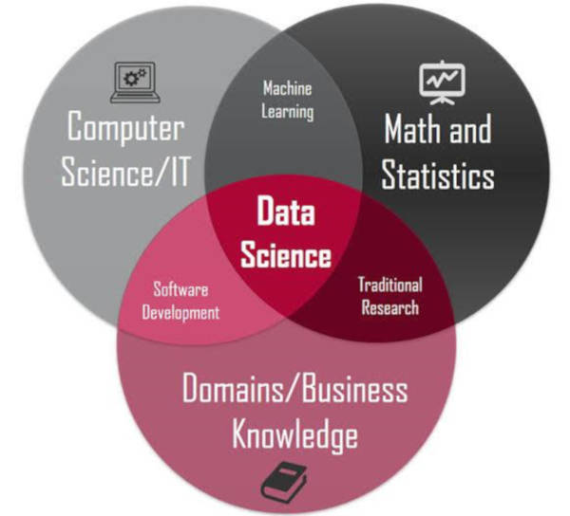
Intro data science Lecture 1
Notes:
Bron afbeelding: https://www.kdnuggets.com/2020/08/top-10-lists-data-science.html
Alternatieve afbeeldingen voor slide:
https://2s7gjr373w3x22jf92z99mgm5w-wpengine.netdna-ssl.com/wp-content/uploads/2018/09/data_science_shutterstock_shutterstock_Trueffelpix.jpg
https://2s7gjr373w3x22jf92z99mgm5w-wpengine.netdna-ssl.com/wp-content/uploads/2018/08/data-science-venn-diagram.png

Slide 2
Course goals
Je begrijpt wat het domein van Data Science inhoudt.
Je begrijpt de rol van de Data Scientist, hun proces en hun taken.
Je kunt de dataset analyseren, ontbrekende waarden identificeren en geschikte voorbewerkingstechnieken toepassen om de data klaar te maken voor modellering.
Je kunt de zakelijke doelstellingen van een machine learning-component formuleren en de relevante gestructureerde dataset correct laden en verkennen.
Je kunt een geschikt machine learning-model selecteren, trainen en valideren, en de prestaties evalueren met relevante meetmethoden.

Slide 3

Grading: Portfolio 1/2
You will build up your Data Science portfolio with assignments which you will work on during and after class.
Assignments will be a combination of
Individual and group-assignments
Fixed format and free choice
Code and documentation
You are free to add any Data Science-related work you performed to your portfolio, even if it was not part of any assigment. This purely optional but will have a positive contribution to your final grade. Not sure if something is Data Science-related? Ask the teachers.
Portfolio assignments will be identified by this icon:

Slide 4
Grading: Portfolio 2/2
Assessment
You explain your portfolio will during the assessment
Think about questions as Why are your doing it? What are your findings? Is it what you expected etc.

Slide 5

Portfolio assignment 1
What is Data Science?
Split yourselves in groups of 3-4 students.
10 min: Do online research, individually, to answer the question “What is Data Science?”*
10 min: Create a PowerPoint slide with a summary of your results*
Now or outside training: Same assignment but the question is “What does a Data Scientist do?”*
*Do not use Avans school materials as a source for this assignment
Notes:
Don’t use Avans materials for your online research.
Tip: Use different sources like Universities, Companies, Dictionaries.

Slide 6
What is Data Science?
“Data science is an inter-disciplinary field that uses scientific methods, processes, algorithms and systems to extract knowledge and insights from many structural and unstructured data… Data science is a ‘concept to unify statistics, data analysis and their related methods’ in order to ‘understand and analyze actual phenomena’ with data. It uses techniques and theories drawn from many fields within the context of mathematics, statistics, computer science, domain knowledge and information science.” - Wikipedia
“Effective data scientists are able to identify relevant questions, collect data from a multitude of different data sources, organize the information, translate results into solutions, and communicate their findings in a way that positively affects business decisions.” - Berkeley
Notes:
https://en.wikipedia.org/wiki/Data_science
https://ischoolonline.berkeley.edu/data-science/what-is-data-science/

Slide 7
What is Data science?
Source: https://www.kdnuggets.com/2020/08/top-10-lists-data-science.html

Slide 8
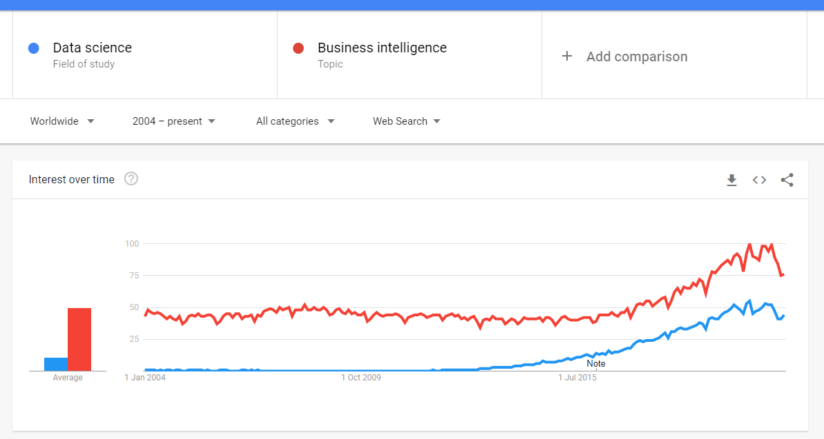
Data Science vs BI
Source: https://trends.google.com/trends/explore?date=all&q=%2Fm%2F0jt3_q3,%2Fm%2F016jq3

Slide 9
Data Science vs BI
Data Science
The data scientist is skilled in technology and content.
The data scientist digs for the right data himself to provide himself with the right information.
Uses the OLTP and OLAP environments as possible sources.
Business Intelligence
The ICT owns the technology but not the content.
The ICT person ensures that everyone in an organisation is provided with the right information at the right time.
Setting up and maintaining data warehouse (OLAP) and reports.

Slide 10
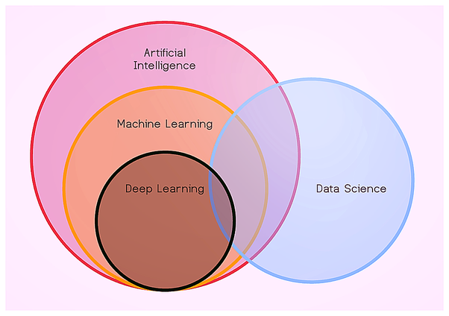
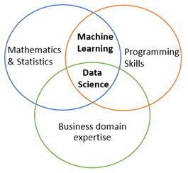
Data science, AI, machine learning
source: quora.com
source: blog.insightdatascience.com
AI: intelligence demonstrated by machines
Machine learning: computer learns without being explicitly programmed
Deep learning: neural network with at least one hidden layer

Slide 11

This course
Walk a mile in the shoes of a data scientist.
To improve your abilities to cooperate with data scientists
The first steps in your journey as data scientist

Slide 12
What does a Data Scientist do?
Turns data into actionable insights
Explore customer data to extract useful information
Identify customers segments based on customer data
…
Create data products:
Build a product recommender based on customer & product data
Predict customer churn* based on customer data
Predict product sales based on sales data
…
*churn: the loss of clients or customers.

Slide 13
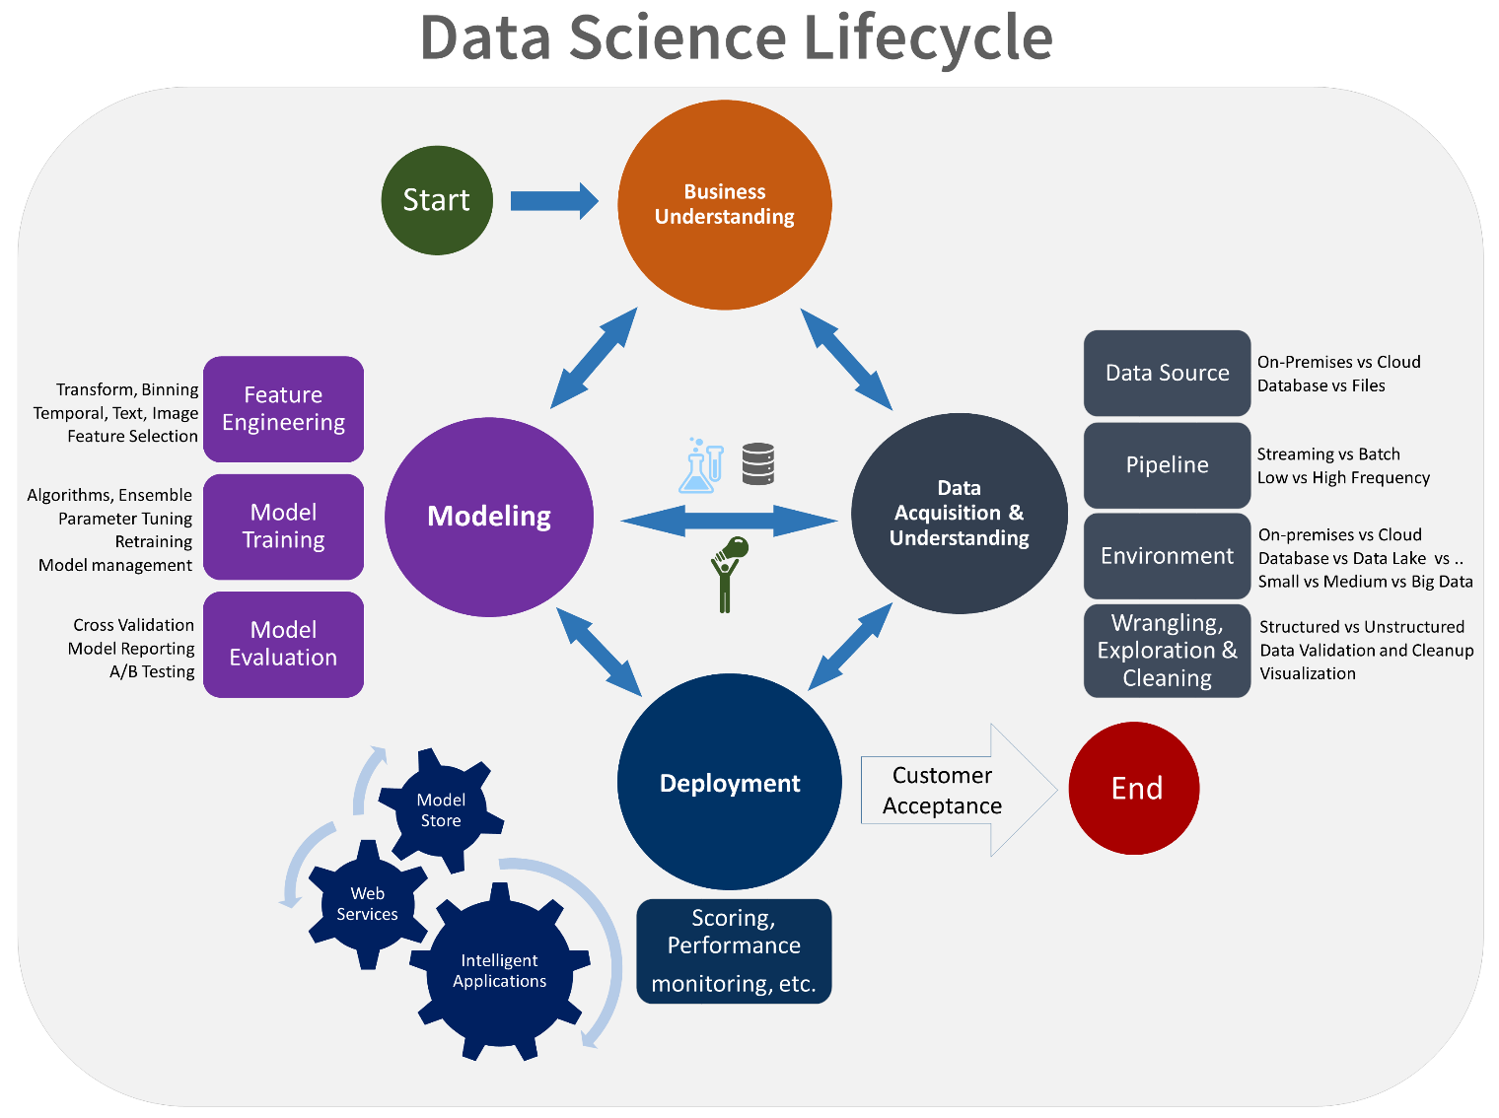
How does a Data Scientist do this?
Source: https://docs.microsoft.com/en-us/azure/machine-learning/team-data-science-process/lifecycle
Notes:
Not a linear process.

Slide 14
Portfolio assignment 2
What are the most popular data science tools?
You will be split up into breakrooms with 3-4 students each.
10 min: Do online research to answer the question “What are the most popular data science tools?”*
10 min: Create a PowerPoint slide with a summary of your results
Optional: Same assignment but the question is “What are the characteristics that make these tools popular for data science tasks?”*
*Do not use Avans school materials as a source for this assignment

Slide 15
Data science tools
Programming languages
Python with Jupyter Notebooks
Julia
R with RStudio
…
Software
Anaconda, PyCharm, Cursor, Visual Composer
SAS
SPSS
RapidMiner
…
Important differences
Programming Languages vs Software
Open-Source/Free vs Proprietary

Slide 16
Data Science tools
What do we need?
Iterative nature of data analysis -> Interactive environment-> REPL/Notebook
Custom logic for data manipulation -> Programming language
Don’t reinvent the wheel -> Toolbox -> Libraries/packages -> Cheatsheets
Visualising the data -> Plotting tools -> GUI

Slide 17
Installing the tools
https://www.anaconda.com/products/individual#Downloads
Demo in class
Notes:
Download anaconda
Open “Anaconda Prompt”
Type and run: conda create -n “datascience“
Type and run: conda activate datascience
Type and run: conda install pip
Type and run: pip install notebook
Type and run: jupyter notebook

